Slide 1
K Scholars Program
Support for Career Development to Enhance Health, Lengthen Life, and Reduce Illness and Disability
Sylvie Naar, PhD
Director, Center for Translational Behavioral Science
Director, FSU K Scholars Program

Slide 2
National institutes of health Research Training and CAREER Development
Research Career Development
Awards (K01, K07, K22, K23, K25) and Small/Exploratory/Pilot Grants (R03, R21, R34)
Predoctoral Fellowship (F31)
or Short-term Training
Support (T35)
Independent
Scientist or Mid-
Career Award
(K02, K05, K18,
K24, K26)
Postdoctoral
Training Support
(T32, F32, K99/R00)
Research
Project
Grant (R01)
Early
Career
(Inst or Asst Prof)
Mid-Career /
Change
(Assoc or Full Prof)
STAGES:
Graduate or Medical School
Post-Doc

Slide 3
Benefits OF A K AWARD
To support you to become an independent researcher
To protect your time for research activity
To formalize and ensure quality mentorship
To generate pilot data
To increase the likelihood of having your own R01

Slide 4
Research career development AWARDS
Mentored Research Scientist Career Development Award (K01)
Academic Career Development Award (K07)
Career Transition Award (K22)
Mentored Patient-Oriented Research Career Development (K23)
Mentored Quantitative Research Career Development Award (K25)
Faculty Development Award to Promote Diversity (K01; IC-specific, e.g., NIDCR, NHLBI, NINDS, NCI)
FEATURES
Duration: 5 years (max)
Mentor: Yes
Salary: Up to $100,000 DC
Res. Costs: Up to $50,000 DC
Renew: No

Slide 5
NEW INVESTIGATOR CAREER AWARDS: PATHWAY TO INDEPENDENCE
Mentored Research
Scientist Development
(K99/R00)
“Kangaroo”
FEATURES
Eligibility: < than 4 yrs postdoc
Duration: 5 years (max); 1-2 yrs mentored, 2-3 yrs independent
Mentor: Yes
Initial period
Salary: Up to $100,000 DC
Res. Costs: Up to $30,000 DC
Independent Award
Res. Costs: Up to $249,000 DC
Renew: No

Slide 6
K SUCCESS RATES HIGHER THAN R01
 | 2014 | 2015 | 2016 | 2017 | 2018
R01 | 18.8% | 18.9% | 20% | 19.3% | 21.7%
K01 | 35% | 33.6% | 32.1% | 31.5% | 31%
K07 | 19% | 25.3% | 27.4% | 14.5% | 28.2%
K22 | 15% | 22.9% | 24.2% | 18.6% | 18.7%
K23 | 38% | 35% | 36% | 34% | 37.7%
K25 | 27% | 22.6% | 24.6% | 23.5% | 17.1%
K99 | 22% | 22.3% | 23% | 23.4% | 26.2%

Slide 7
NIH Scholars Program at UF
Grant Writing Workshops & Development Bootcamps
Virtual Live Stream
Recorded and PPTs
In Person (Pending Participation Number)
Potential Secondary Mentors Among UF Senior Faculty
Career Development Toolkits
https://www.ctsi.ufl.edu/education/grant-workshops/k-college-toolkit/
Library of K awards and summary statements
Boilerplate resources (e.g., responsible conduct of research, rigor and reproducibility

Slide 8
Granting Writing Opportunities for Early Stage Investigators at the UF HSC
Grant-writing Clearing House
F Writers’ Workshop and Toolkit
K Writers’ Workshop and Toolkit
Pilot Study Writers’ Workshop
Diversity Supplement Writers’ Workshop
K to R Bootcamp
NIH Loan Repayment Program Workshop

Slide 9
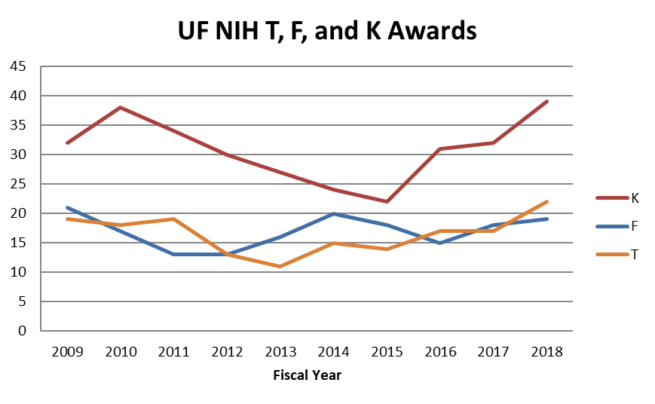
*Record high number for UF
Data from NIH RePORTER

Slide 10
New K SCHOLARS PROGRAM AT FSU
Develop a community of K Scholars and mentors
Establish mentoring teams
Support initial K applications to NIH by February 2020
Virtual and in-person workshops and boot camps
Initiate competitive NIH-funded KL2 Scholars (2) and internally funded K Scholars (1)
Provide ongoing professional development
Training courses (in person and virtual)
Listserv and website resources

Slide 11
Questions?

