Slide 1
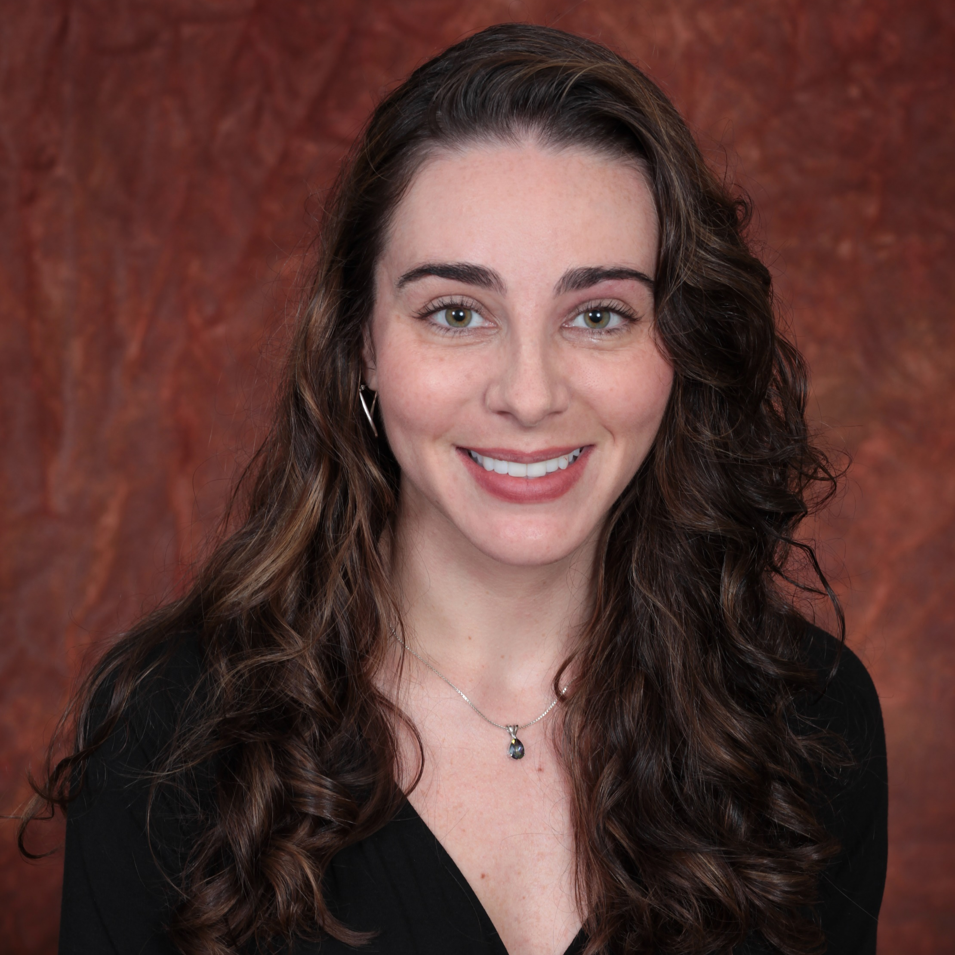
Suzanne Baker
Geriatrics
suzanne.baker@med.fsu.edu
Exploring Depression in Older Adults
Medical Education Research
Disparities in health outcomes for older adults, depression, research methodology and ethics, medical education
I can assist with survey methods, development of grant proposals, monitoring research projects, writing and submitting Institutional Review Board applications, as well as, mentoring students.

