Slide 1
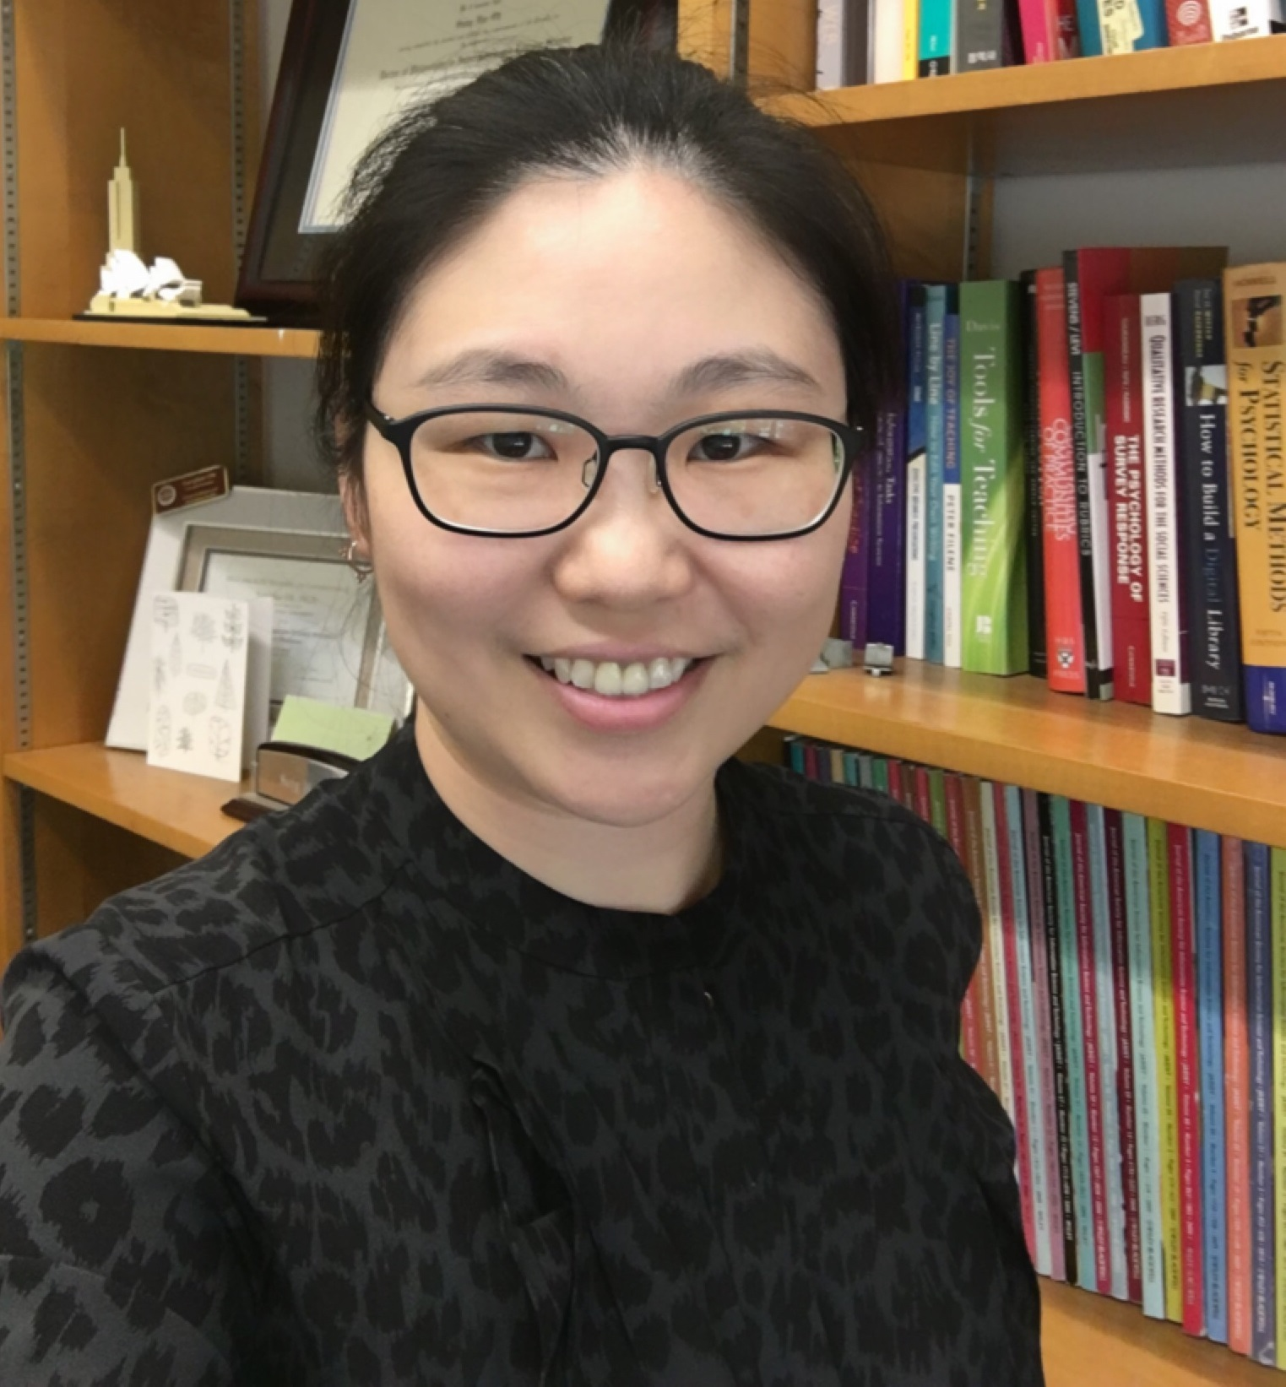
Sanghee Oh
School of Information
shoh@cci.fsu.edu
Social Media & Health Information Behavior Research. Funded by OCLC/ALISE Library & Information Science Research Grants
Cancer Information Needs Assessment in Social Media
Using the Methods of Content Analysis and Text Mining
Big social data analysis, health data analysis
Health information technology promotion and education for seniors
I utilize a mixed method approach to incorporate both qualitative and quantitative data collection and analysis. Methods used include surveys, content analysis, and text mining. I work in collaboration with international and interdisciplinary scholars.

