Slide 1
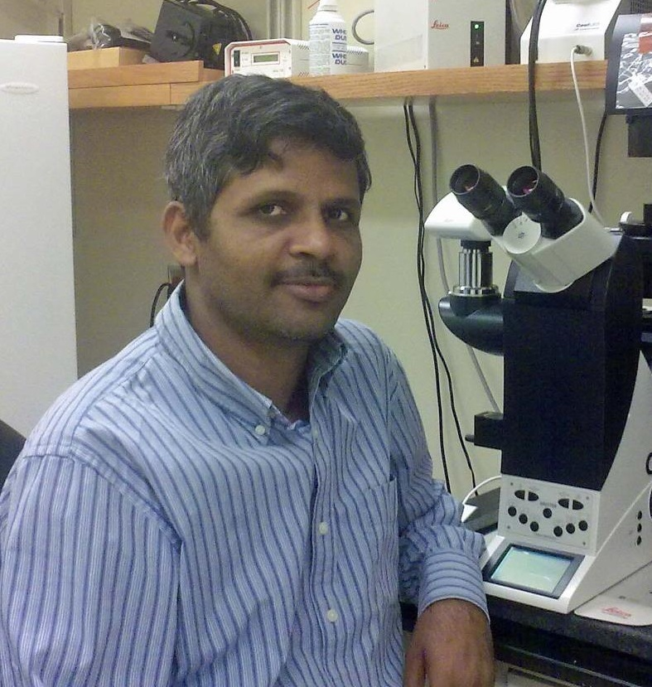
Rakesh Singh
Translational Research Laboratory
rakesh.singh@med.fsu.edu
Global proteome profiling and analysis
Quantitative proteomics, LFQ/SILAQ/TMT/iTRAQ
Interactome detection and analysis by AE-MS
Microbial/Pathogen detection by MALDI-TOF/TOF
Mass Spectral Imaging
Early Disease Diagnosis and Biomarker Development
Expert in protein-protein interaction analysis by genetic, biochemical and mass spectrometric methods.
Expert in cell/tissue culture, cell based assay development and advanced fluorescent microscopy.
End to end expertise in proteomics technology especially Orbitrap and Q Exactive based proteomic workflows.
Experimental design, proteomic data analysis

