Slide 1
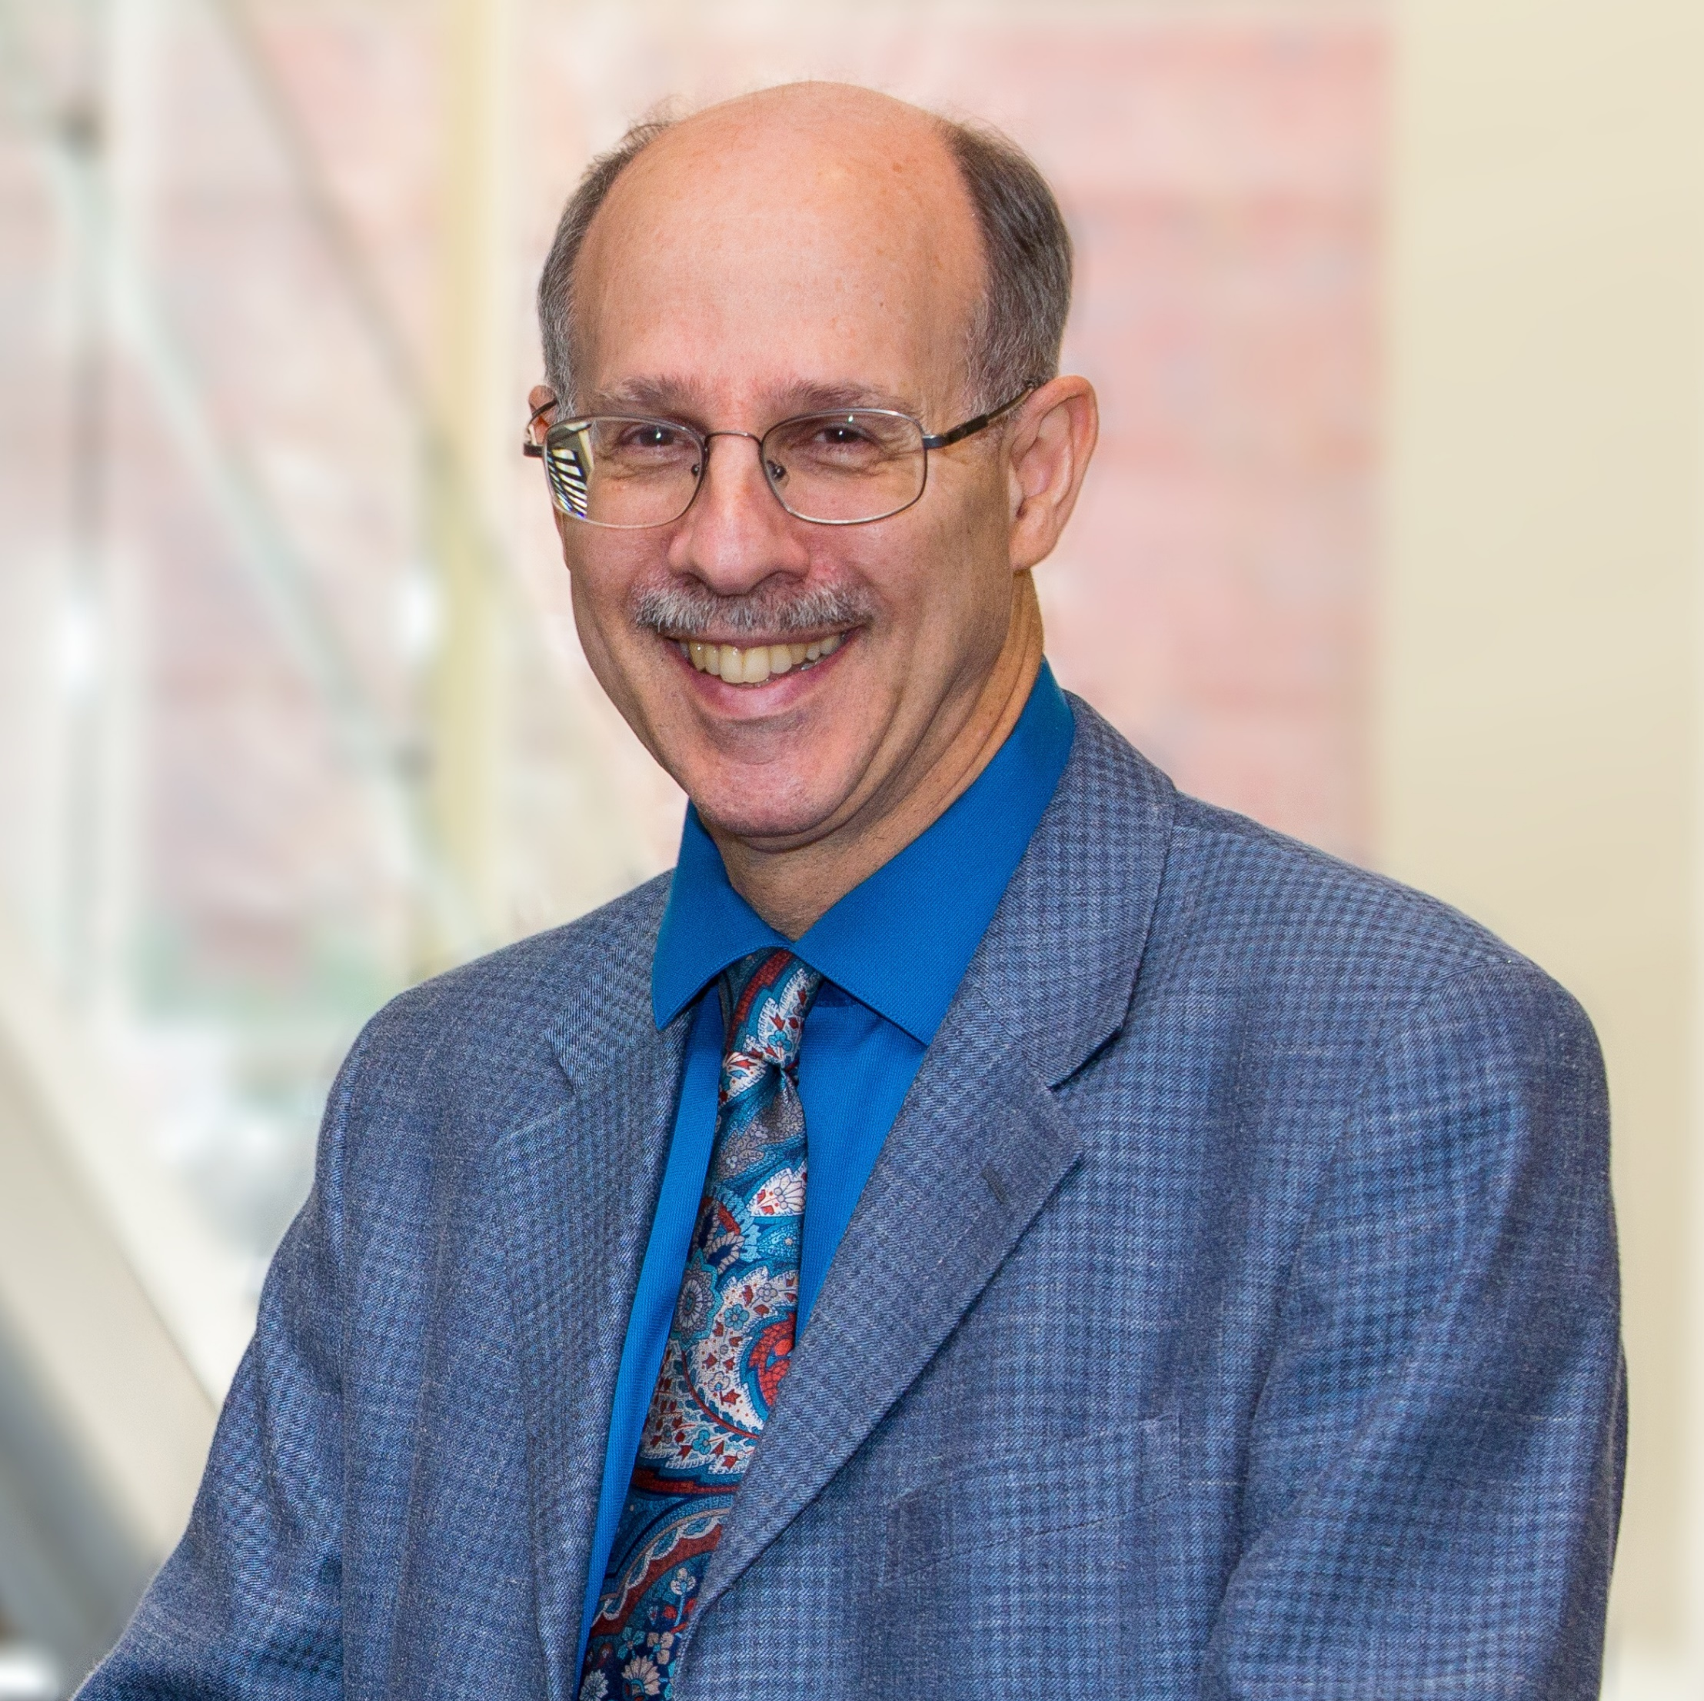
Neil Charness
Psychology
Director, Institute for Successful Longevity
charness@psy.fsu.edu
Human Factors approaches to Aging and Technology Use
  Program Project grant CREATE (www.create-center.org ), funded by NIH/NIA
Aging Driver and Pedestrian Safety research
  University Transportation Center: Accessibility and Safety for an Aging Population, funded by US DOT
  Tip Card design, funded by Florida DOT
How to improve quality of life in aging adults, with an emphasis on technology interventions.
Experience in interdisciplinary collaborative research; knowledge of 1) age and cognition, 2) age and driver & pedestrian safety, 3) age and expertise, 4) age and work performance. Recent projects have explored telehealth interventions for older adults & those with heart failure; computer systems designed to improve social connectivity in older adults at risk for social isolation; use of digital gaming to improve cognition in older adults; simulator studies of aging drivers aimed at improving safe mobility for life.

