Slide 1
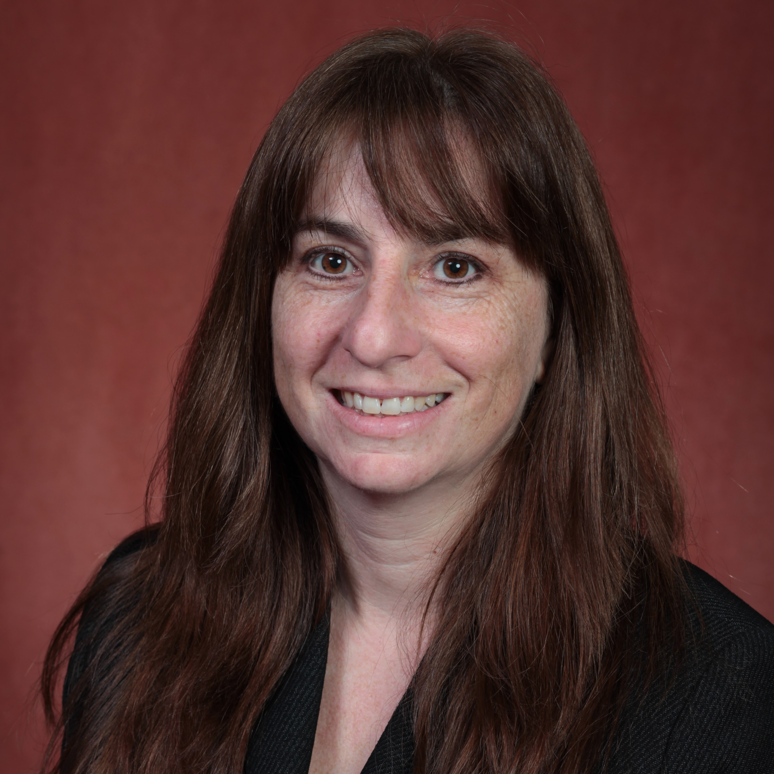
Michelle Arbeitman
Biomedical Sciences
michelle.arbeitman@med.fsu.edu
Genes underlying reproductive behavior and physiology. Funded by NIH, NIGMS.
Immunoglobulin superfamily and sexual dimorphism in the nervous system. Funded by NIH, NINDS.
Chromatin and Behavior. NIH-Pending
Cutting edge approaches to understand master regulatory genes. NIH-Pending.
Understanding the molecular-genetic and neural circuit basis of behavior using Drosophila (fruit fly) and mouse models.
I have strengths using molecular-genetic, genomic and biochemical approaches to address questions related to complex behavior and animal development. In the past I have had productive collaborations with statisticians, quantitative biologists and computer scientists, mostly on my genomic-scale research questions.

