Slide 1
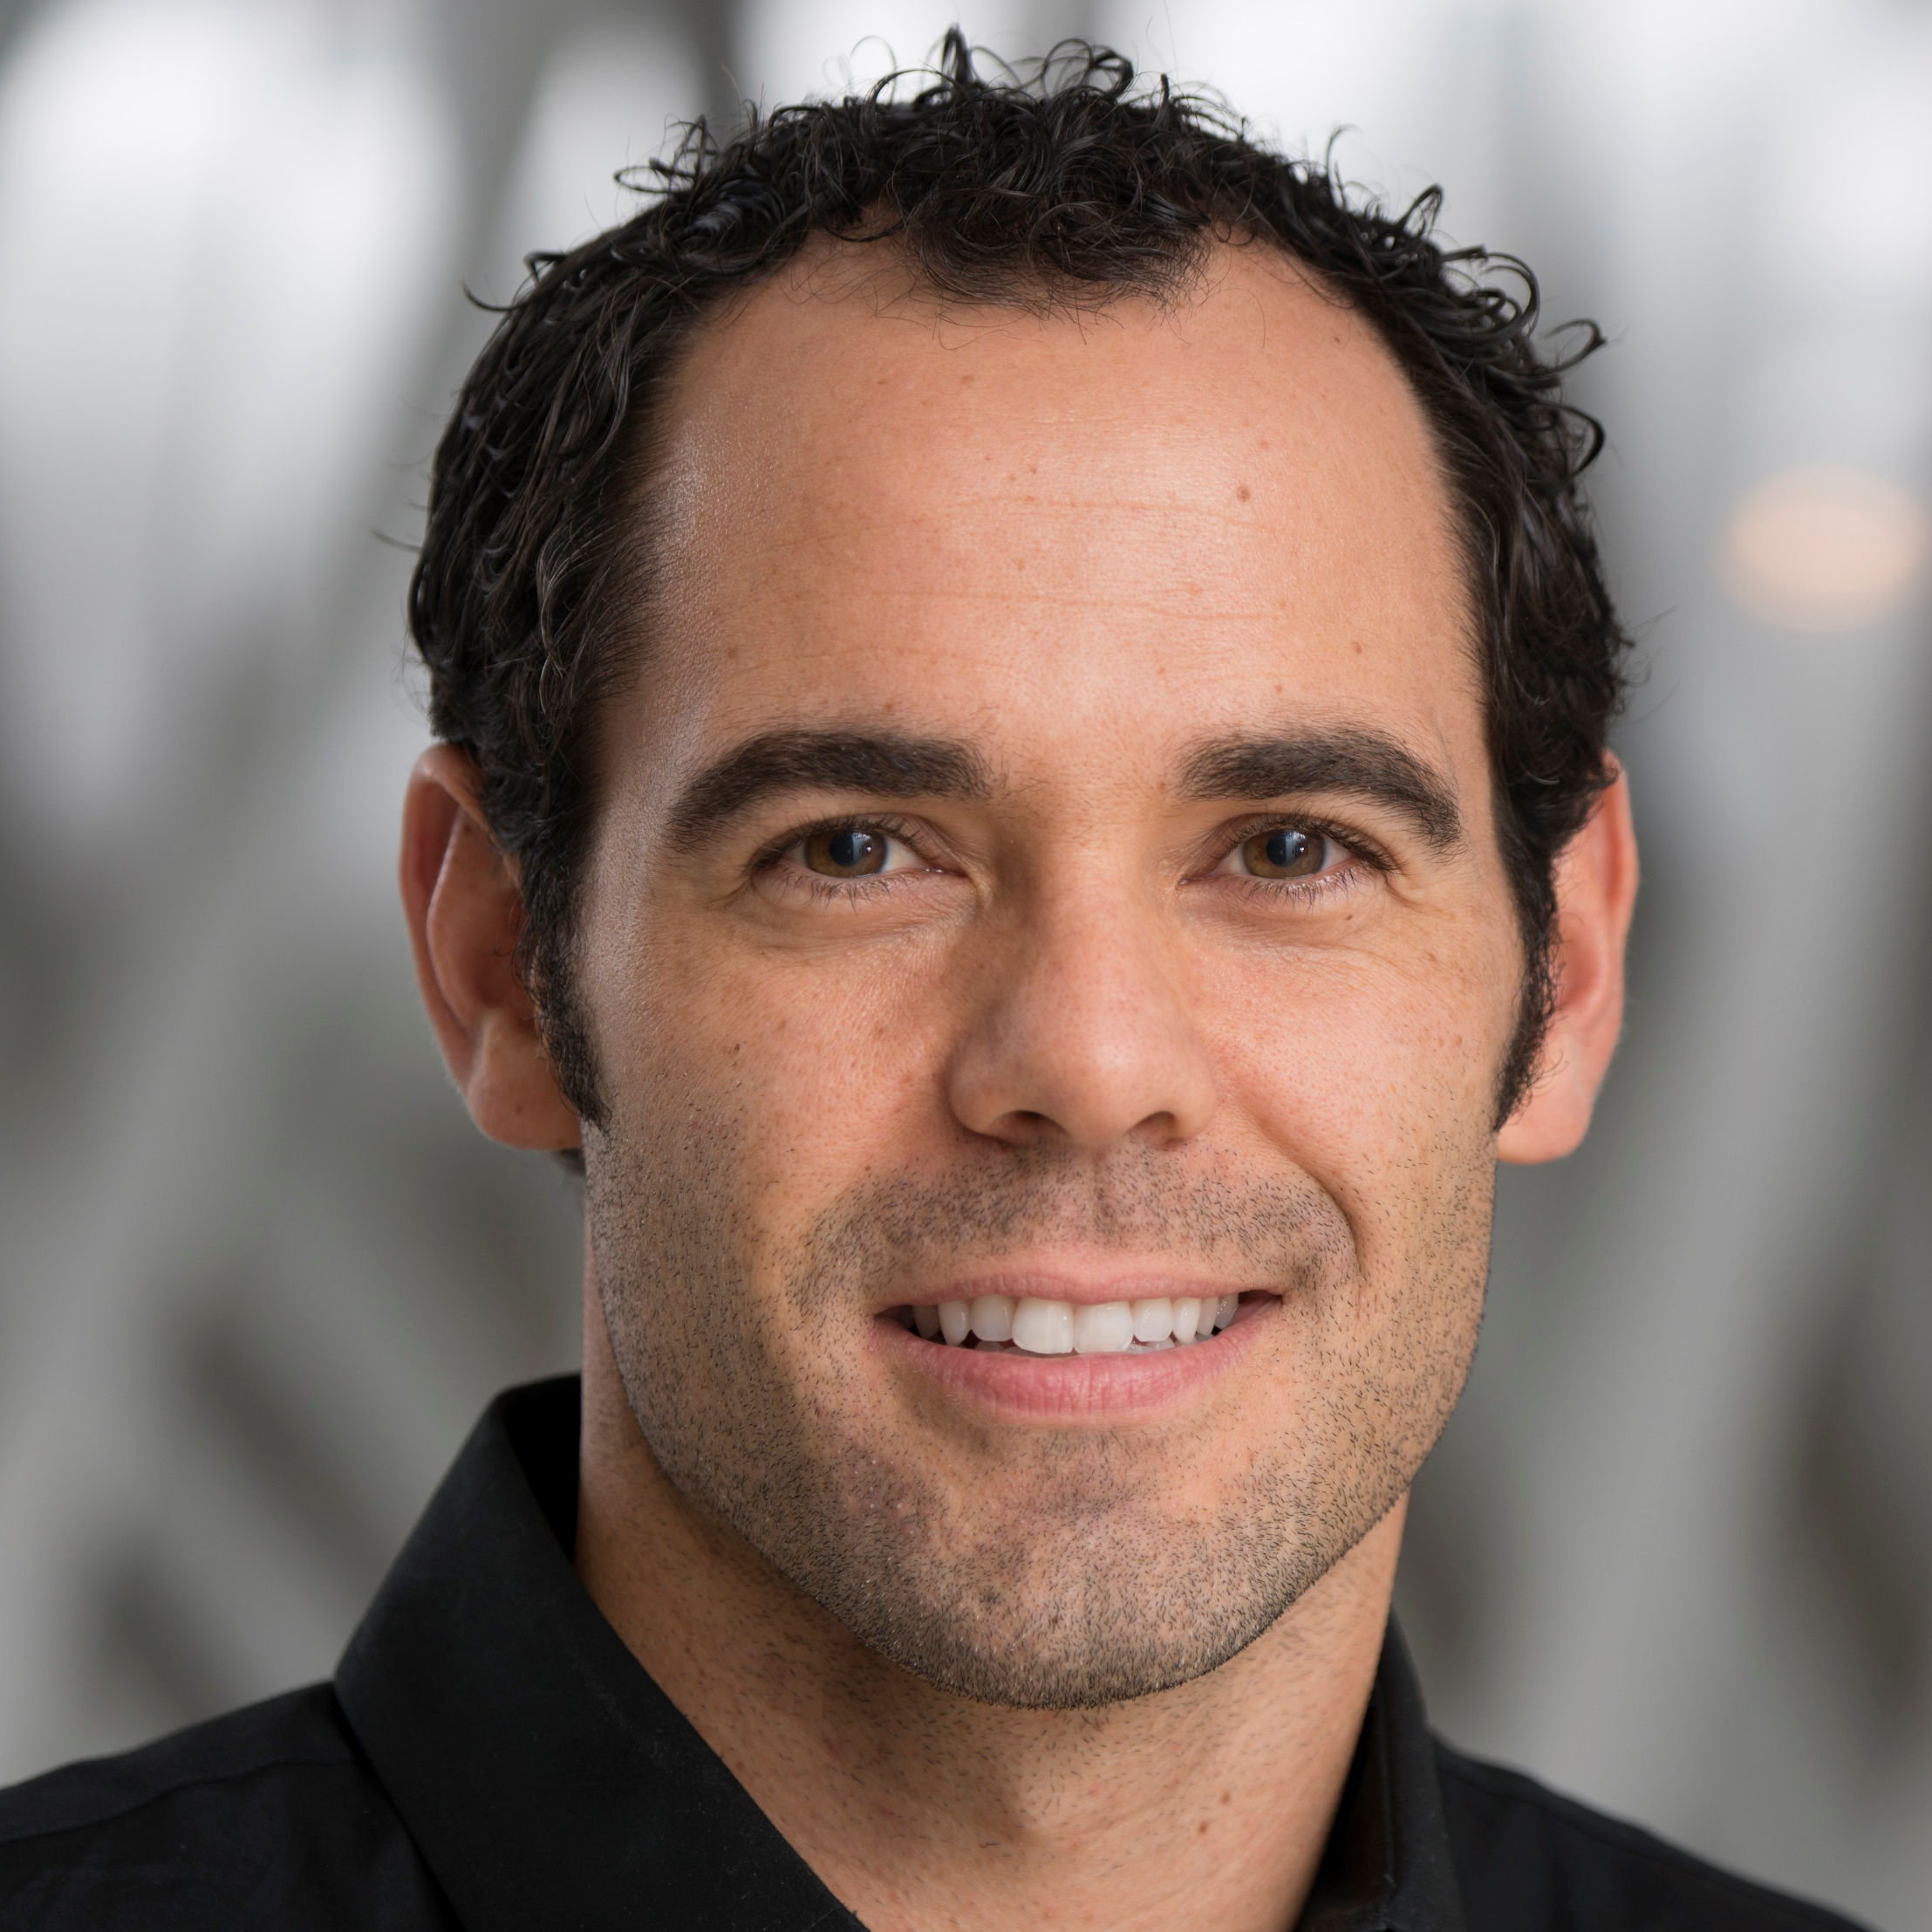
Michael J. Ormsbee
Institute of Sports Sciences and Medicine; Nutrition, Food
and Exercise Sciences
mormsbee@fsu.edu
Protein’s influence on body composition, metabolism, and performance (Dymatize Nutrition, Inc)
Environmental influence on adipose tissue lipolysis and whole-body fat oxidation in trained cyclists (NSCA)
Modified carbohydrate supplementation: fat metabolism and running performance – a pilot study (FSUCRC; DOD application)
Herbal supplementation and concurrent training (Onnit Labs)
Exercise training and nutritional interventions to prevent obesity-related diseases, achieve optimal body composition, and maximize human performance in both healthy (athletes) and diseased populations.
I am an exercise physiologist and performance nutritionist. I can collaborate with design and interpretation in areas related to nutrition, supplementation, metabolism and human performance. At the ISSM we have performance measurement tools and the ability to measure lipolysis from adipose tissue using the microdialyisis technique.

