Slide 1
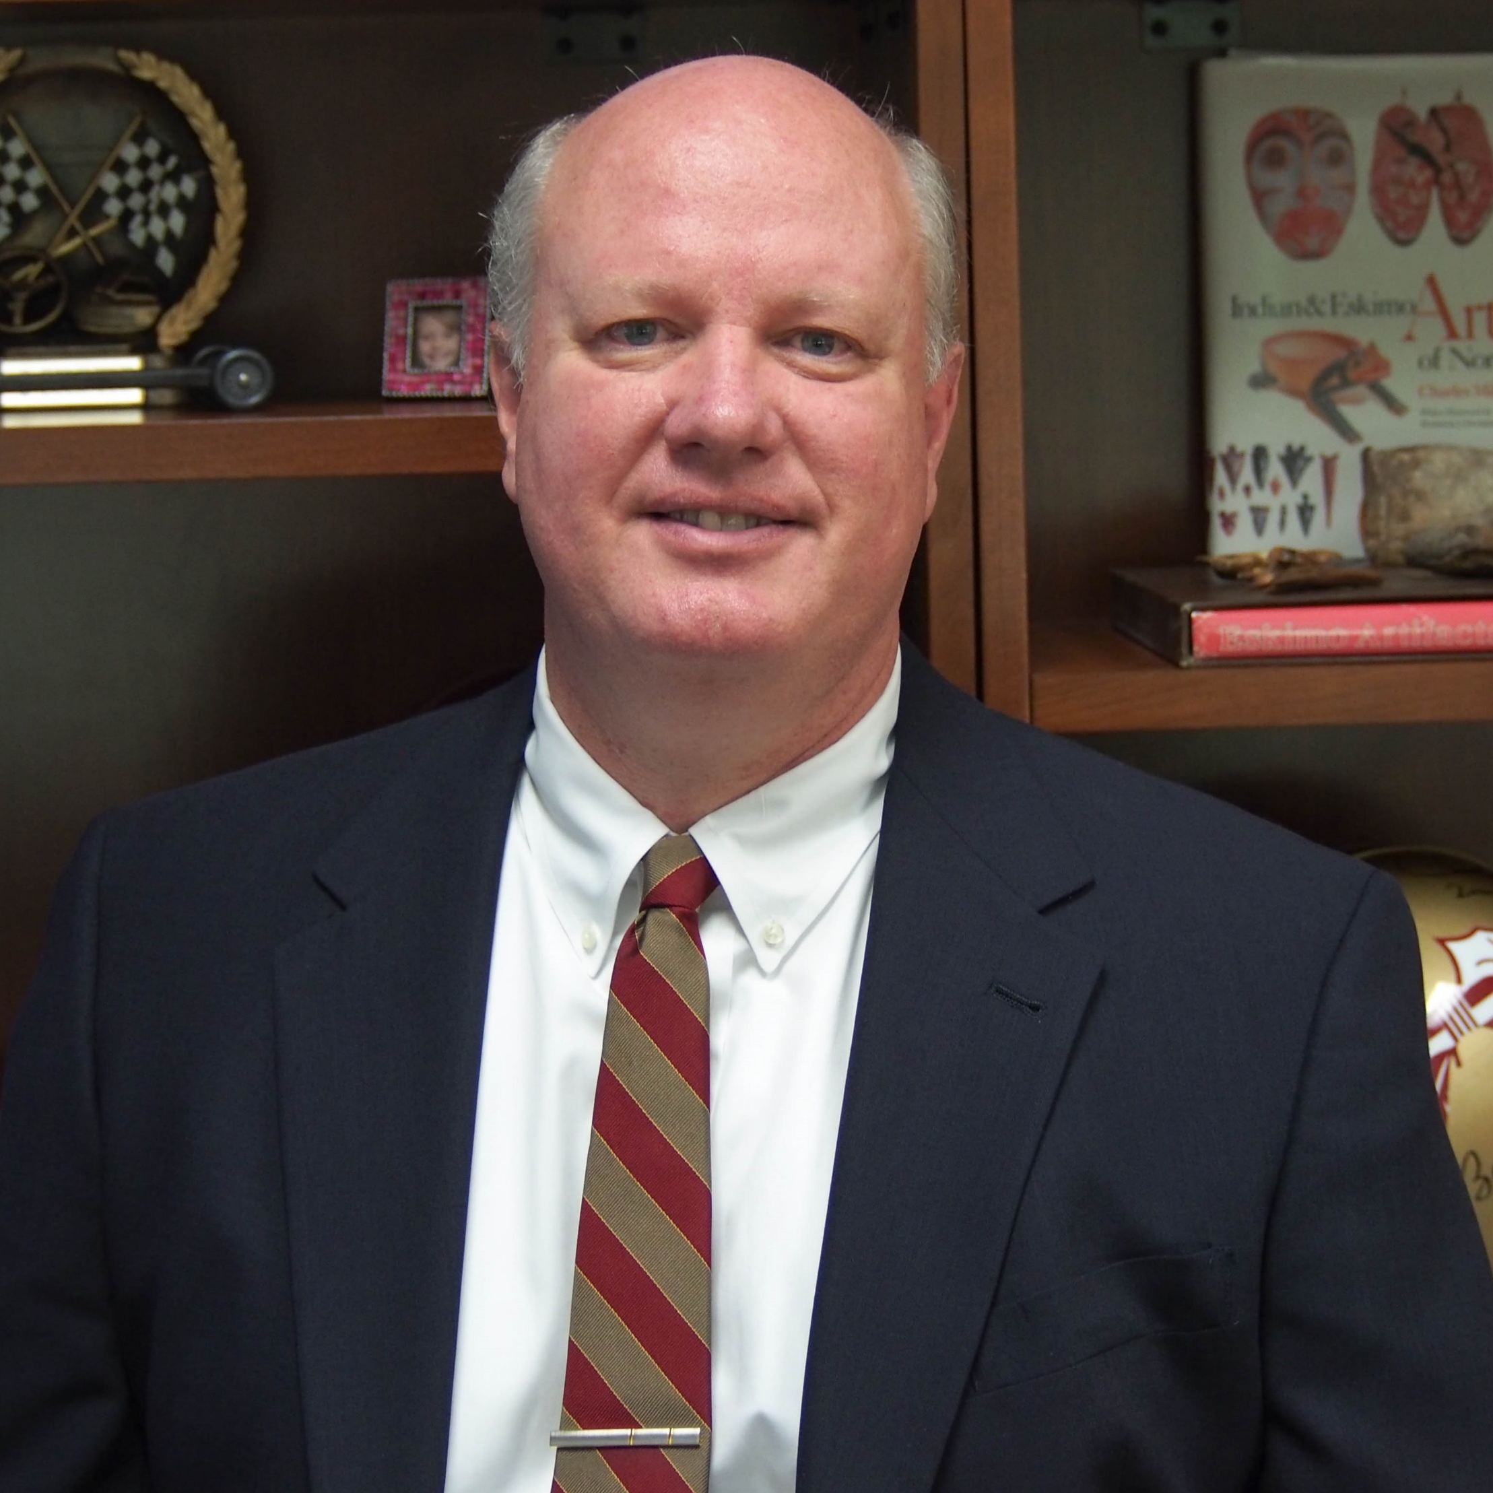
Michael Delp
Nutrition, Food
and Exercise Sciences
mdelp@fsu.edu
The effects of actual and simulated microgravity on microvascular control mechanisms and how these alterations contribute to health risks associated with spaceflight.
The effects of aging and exercise training on vascular control mechanisms in skeletal muscle.
Coupling of blood flow and microvascular endothelial function to bone loss associated with disuse, old age and type II diabetes.
Physical activity, aging, type II diabetes, spaceflight, space radiation and health
Expertise in cardiovascular and exercise physiology, federal funding experience.

