Slide 1
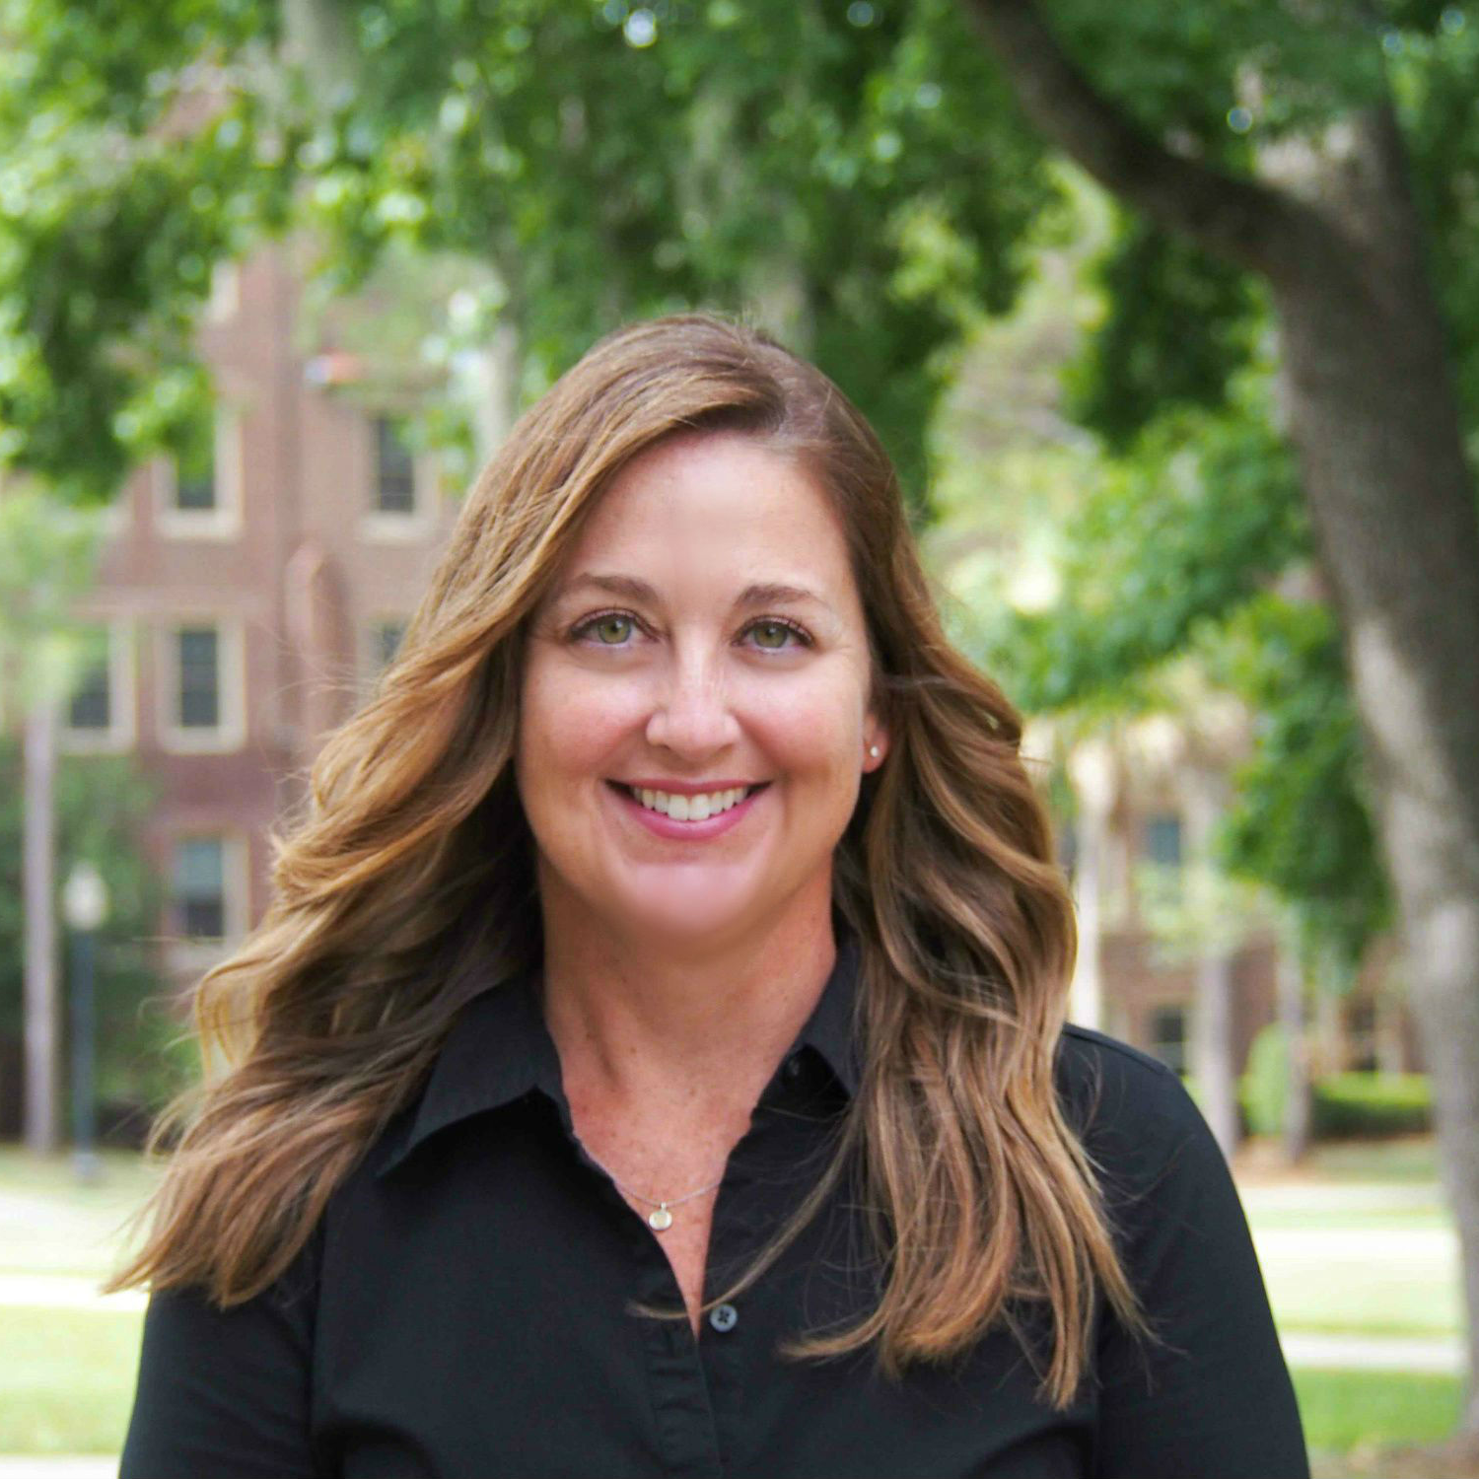
Lenore McWey
Family and Child Sciences
lmcwey@fsu.edu
Evidence-based parenting intervention for adolescents and young adult parents aging out of the foster care system, funded by the Florida Institute for Child Welfare.
Mental health trajectories of adolescents in foster care.
Well-being of families involved with the child welfare system
As a family therapy scholar, I bring a systemic lens to the view of contemporary challenges. I am well versed in advanced statistical approaches including as various dyadic analytic techniques and growth curve analyses. I can help with intervention strategies, study design, recruitment and retention, and statistical approaches particularly with studies of families deemed “at-risk.”

