Slide 1
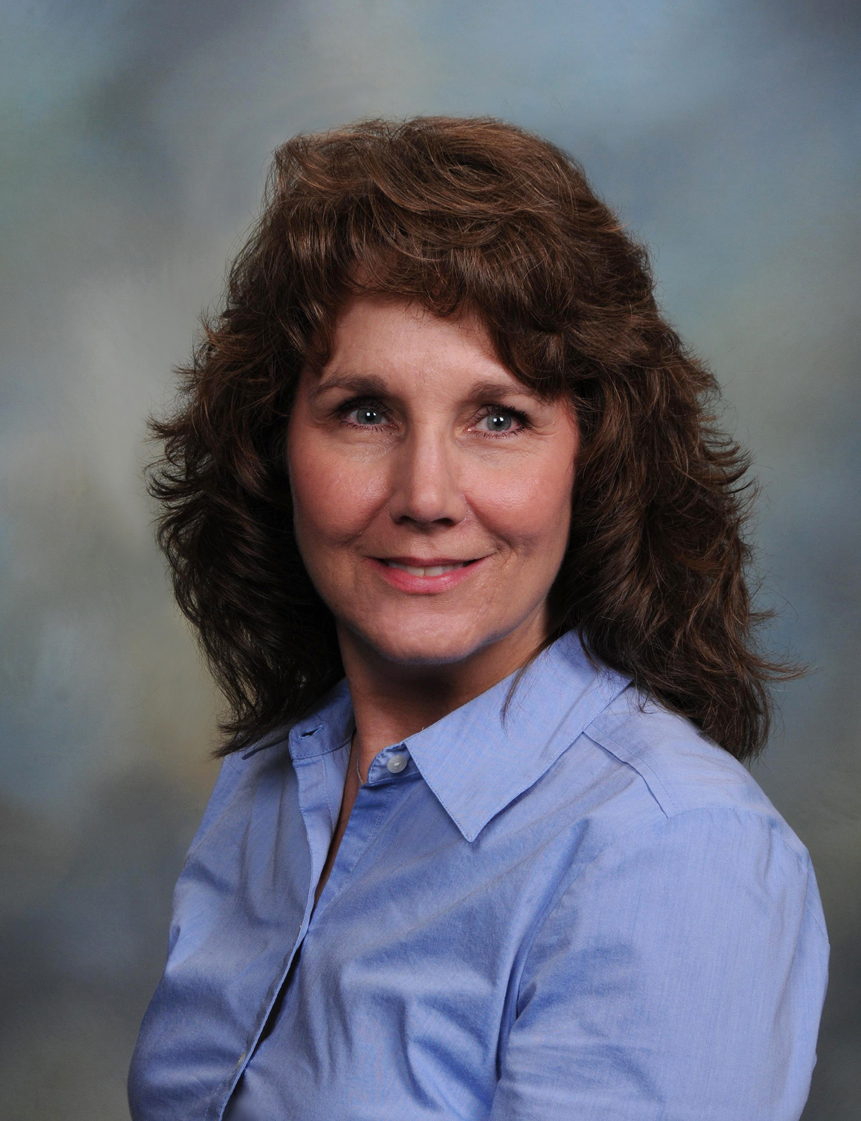
Laurie Abbott
College of Nursing
labbott@fsu.edu
My recent research activity was an experimental design testing a cardiovascular health promotion intervention in a rural population.
Health disparities research
Health promotion interventions among vulnerable and/or rural populations
As a registered nurse with twenty years of experience, I can offer valuable contributions to health research in diverse settings. I have obtained a Health Disparities Research certificate from the University of Illinois at Chicago School of Public Health. I can collaborate with multi-disciplinary researchers in the development, implementation, and analysis of research strategies intended to enhance health and improve health outcomes.

