Slide 1
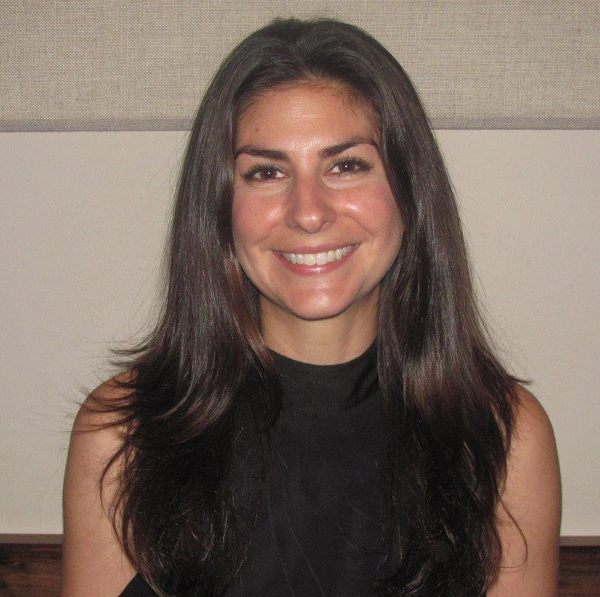
Katie Sherron
Economics
ksherron@fsu.edu
I’m an Associate Teaching Professor and not currently conducting research. I do spend a lot of time staying up-to-date on the Affordable Care Act. I share the information in my graduate and undergraduate Health Economics courses as well as in speaking engagements around campus.
The Affordable Care Act, its implementation as well as short and long term impacts on our health care system.
As an economist, I specialize in understanding how individuals respond to incentives. As a teaching professor, I excel in communicating policy implications and outcomes to students as well as the general public.

