Slide 1
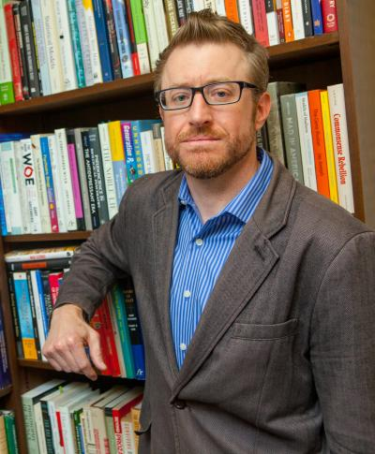
Jeffrey Lacasse
College of Social Work
jlacasse@fsu.edu
Knowledge dissemination regarding psychiatric diagnosis and psychotropic medication; use of psychotropic medications in child welfare and among other vulnerable populations; interventions which provide data-based information to clinicians and clients within the mental health system
Social science research on psychiatric medication
Experience in interdisciplinary research using both qualitative and quantitative methods

