Slide 1
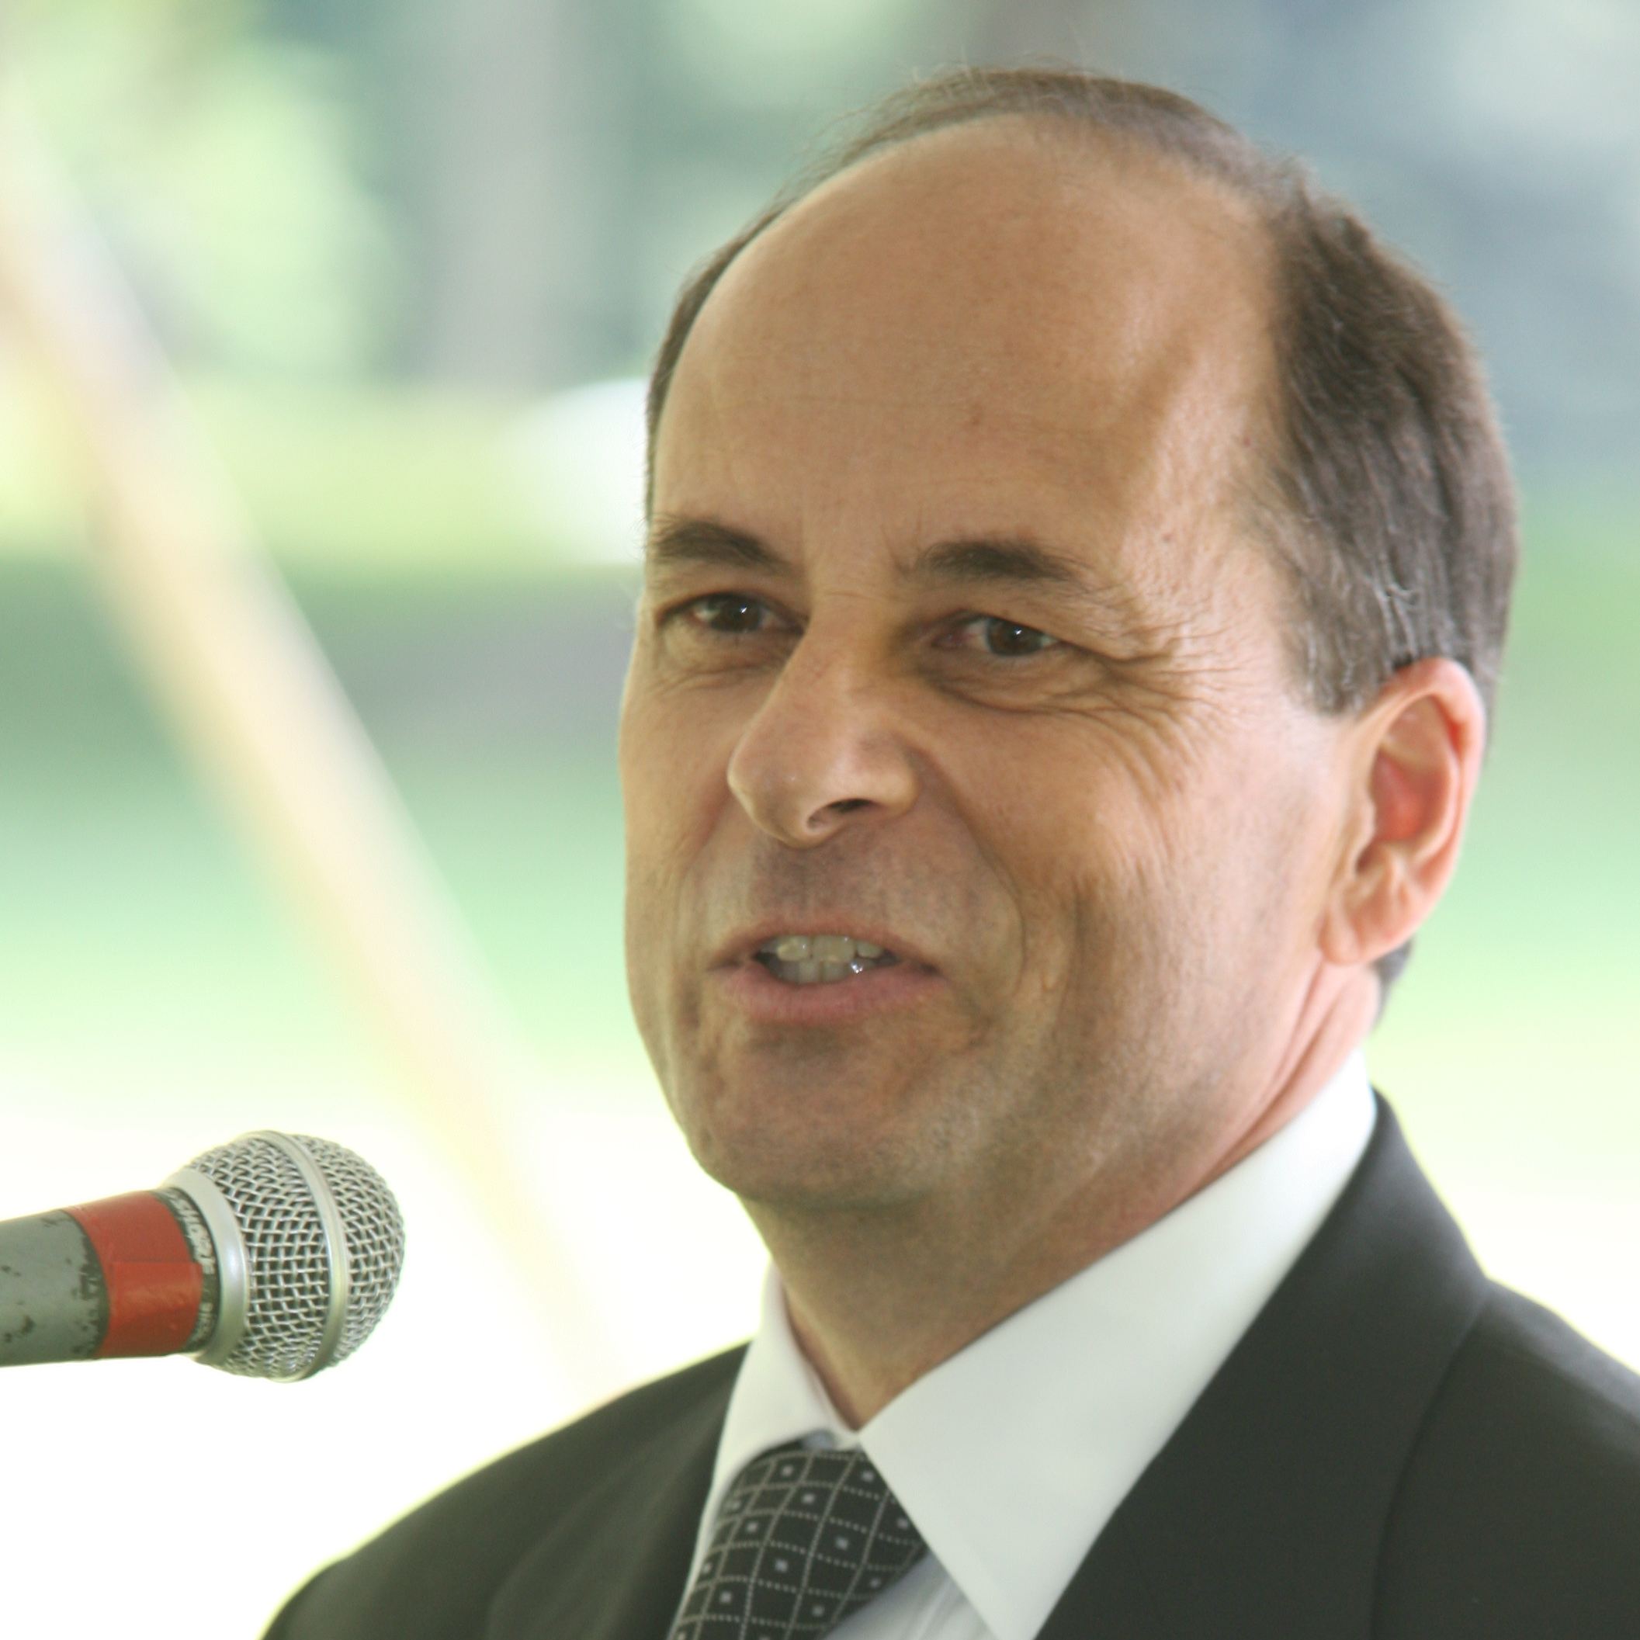
Greg Riccardi
School of Information
griccardi@fsu.edu
Health Informatics
We are collecting health records as part of the OneFlorida Data Trust using resources at the FSU Research Computing Center
Funded through the College of Medicine in collaboration with UF
  PCORI
  CTSA
Integration of health records across a broad spectrum of providers and using those records for Comparative Effectiveness Research
I have many years of experience working with scientists on their informatics needs. My background in computer science and current work with the School of Information and the College of Medicine makes me well-positioned to understand data and information and to prepare information for use in data-intensive research

