Slide 1
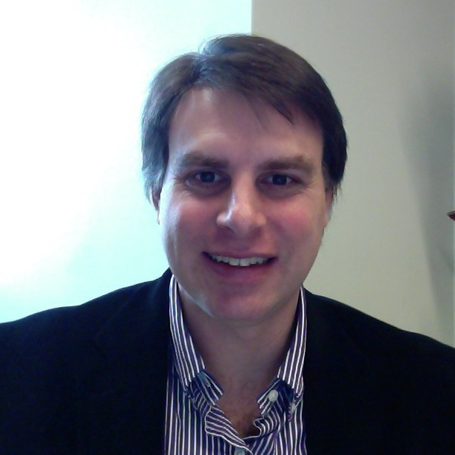
Daniel Kaplan
Biomedical Sciences
daniel.kaplan@med.fsu.edu
My current research focuses on the initiation of DNA replication in budding yeast and human cells. In addition, we are studying how DNA replication proteins may function as potential diagnostic and prognostic markers for cancer. We are also determining how histone and histone chaperones regulate replication initiation.
DNA Replication, Genome Maintenance, and Cancer
I have expertise in DNA replication biology and biochemistry, and I am expert in biochemical techniques to determine how DNA replication is initiated.

