Slide 1
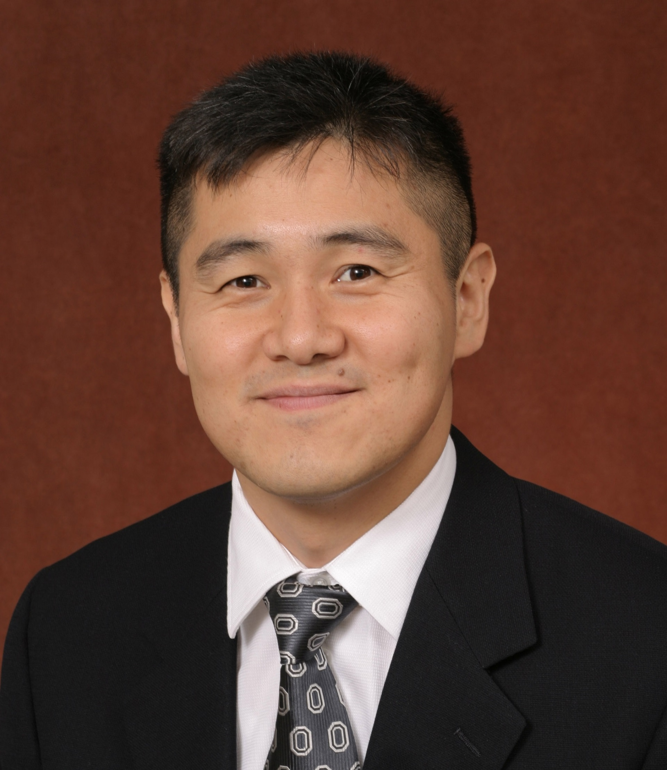
Choogon Lee
Biomedical Sciences
choogon.lee@med.fsu.edu
Synthetic biological clocks to drive circadian rhythms and cell cycle in a regulated manner, Funded by NIH
On/off switch for boosting metabolism (glycolysis and TCA cycle)
New immunoassay technique for detecting antibodies that are diagnostic for HIV infection
Synthetic genetic circuits to control our physiology
I have two decades of expertise in molecular biology and am available to consult/collaborate on any molecular biology experiments involving mammalian physiology. For example, I can solve problems relating to designing/implementing artificial genetic circuits in mammalian cells for biotechnology and gene therapy and developing new diagnostic immunoassays and new biochemical assays.

