Slide 1
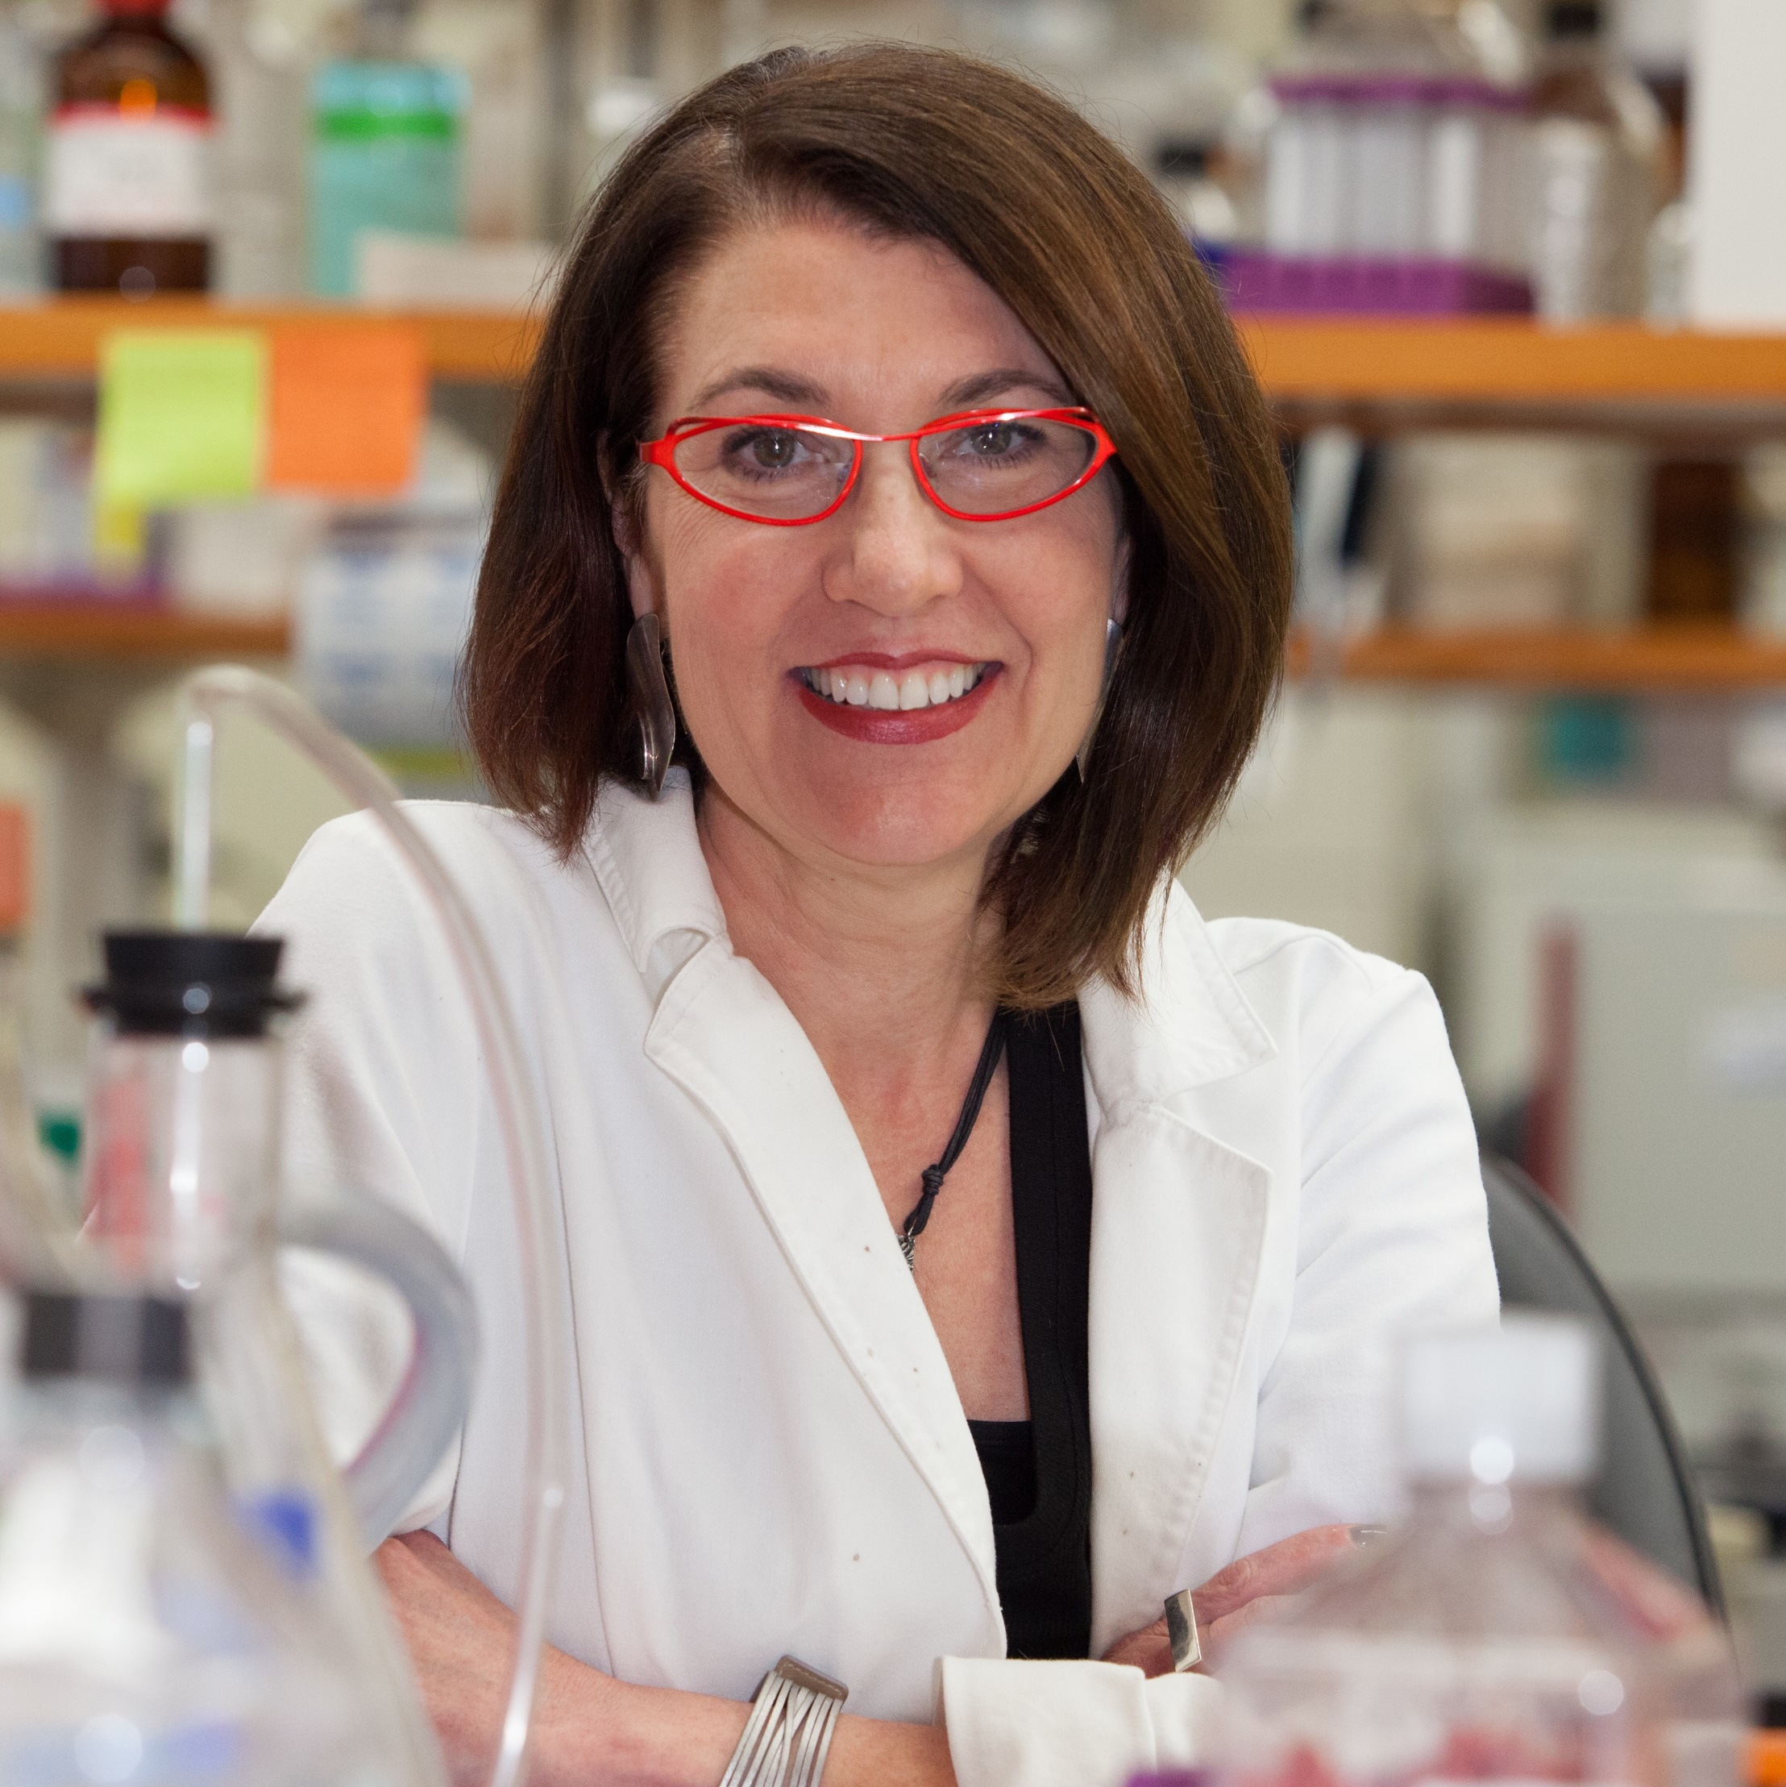
Cathy W. Levenson
Biomedical Sciences &
Program in Neuroscience
cathy.levenson@med.fsu.edu
Use of human stem cells to treat TBI-associated depression
  Darkazalli A, et al. Use of human mesenchymal stem cell treatment to prevent anhedonia in a rat model of traumatic brain injury Neurorestorative Neurology & Neuroscience 2016 (in press)
  Darkazalli A, et al. Human mesenchymal stem cell treatment normalizes cortical gene expression after traumatic brain injury. Journal of Neurotrauma 2016 (under review)
Role of zinc in stem cell regulation, neurogenesis, & depression
  Cope EC, et al. Effect of zinc supplementation on neuronal precursor proliferation in the rat hippocampus after traumatic brain injury. Exp Neurology 2016, 279:96-103.
Traumatic Brain Injury (TBI) – with a particular emphasis on depression and depression-related disorders
Therapeutic uses of adult stem cells
Use of a well-validated pre-clinical model of brain injury
Administration of adult human mesenchymal stem cells (hMSC)
Wide range of molecular and cellular tools including genomics (RNAseq), histological monitoring of adult neurogenesis, and hMSC tracking
Use of a full battery of pre-clinical behavioral tests for depression, anxiety, learning, and memory, and sensory-motor skills

