Slide 1
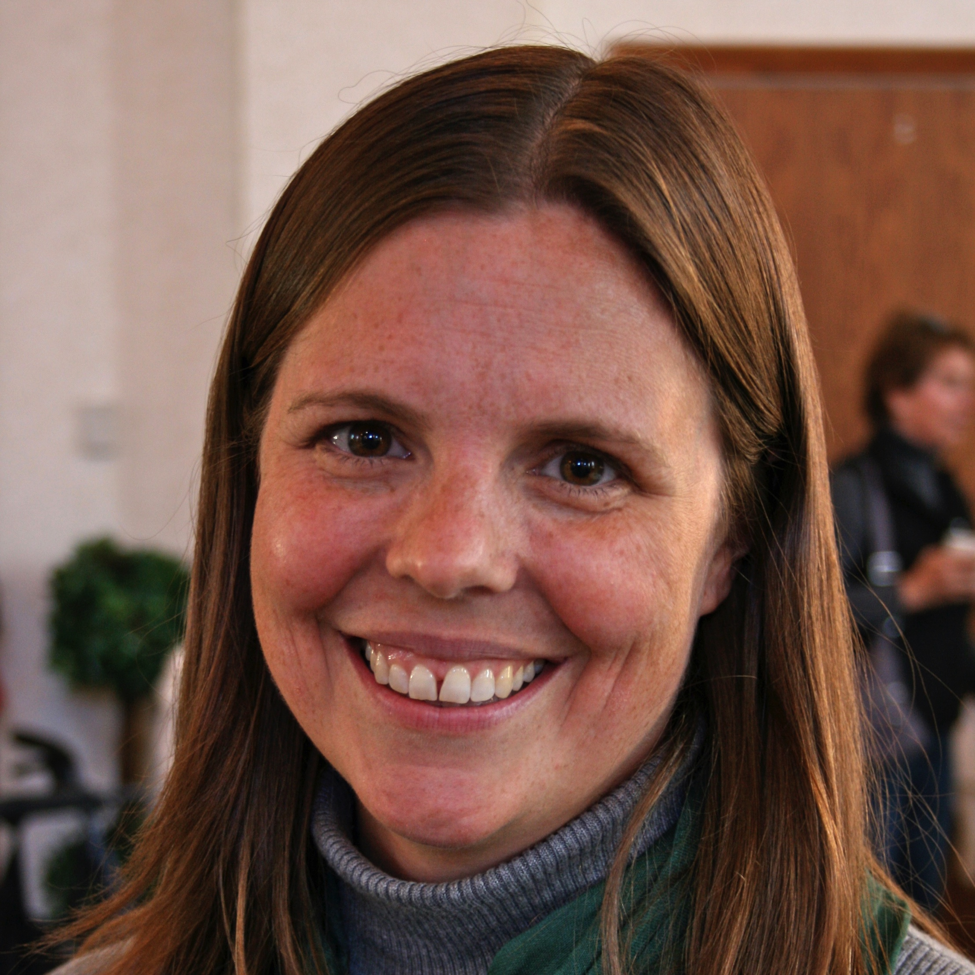
Beth Stroupe
Biological Science
Institute of Molecular Biophysics
mestroupe@bio.fsu.edu
I am interested in understanding the structural biology of molecules that are involved in basic cellular function. Of particular interest are molecules important for sulfur metabolism in Escherichia coli (funded by the NSF) and Mycobacterium tuberculosis (new grant application to the NIH). Additionally, we are funded through a subcontract from TSRI-FL and the NIH to study ribosome assembly. We use a combination of biochemistry, X-ray crystallography, and cryogenic 3D microscopy (cryo-EM) to explore these molecules.
I am interested in understanding the structural biology of molecules that are involved in basic cellular function.
Cryo-EM has recently exploded into the research scene with new technology that allows higher-than-ever resolution. This puts it on par with X-ray crystallography in terms of its potential in drug discovery efforts. It is exciting to be at the fore-front of this revolution because FSU is an important player, being one of the first public research institutions to acquire a Titan Krios (FEI) instrument.

